Slide 1
Leaderless Replication

Slide 2
Types of replication
Single leader
Multi leader
Leaderless

Slide 3
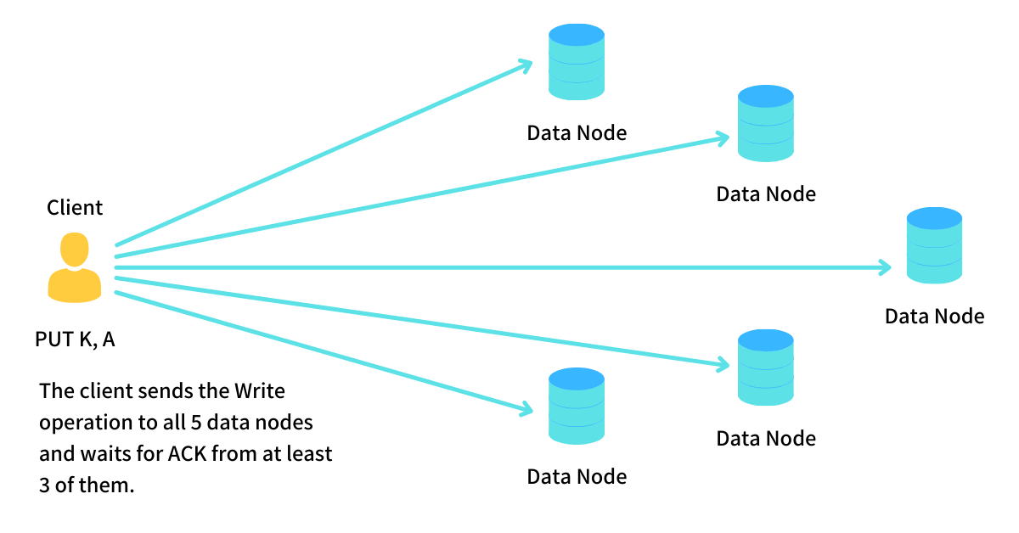
Leaderless Replication Overview
Any replica can accept a write from a client
Send reads and writes to all nodes in parallel, once a certain predefined threshold of nodes return a success value, the client is told that the read/write was successful

Slide 4
Keeping data up to date
Anti-Entropy
Read Repair

Slide 5
Anti Entropy
Background process looks at multiple nodes and their stored values, use version numbers of the data in order to attempt to make sure that each replica holds the most up to date copy of the data

Slide 6

Read Repair
Idea: Since we are reading from multiple replicas in parallel, take the most up to date piece of data and propagate it to the other replicas that had outdated data
DB1
DB2
DB3
Value of key jordan?
[20]
jordan: sexy
[18]
jordan: cute
[19]
jordan: mid

Slide 7
Read Repair
Idea: Since we are reading from multiple replicas in parallel, take the most up to date piece of data and propagate it to the other replicas that had outdated data
DB1
DB2
DB3
Value of key jordan?
argmax [(20, sexy), (18, cute), (19, mid)]
Result: jordan = sexy
Need to write back to db2 and db3
[20]
jordan: sexy
[18]
jordan: cute
[19]
jordan: mid

Slide 8
Read Repair
Idea: Since we are reading from multiple replicas in parallel, take the most up to date piece of data and propagate it to the other replicas that had outdated data
DB1
DB2
DB3
Value of key jordan?
argmax [(20, sexy), (18, cute), (19, mid)]
Result: jordan = sexy
Need to write back to db2 and db3
[20]
jordan: sexy
[20]
jordan: sexy
[20]
jordan: sexy

Slide 9
Read Repair
Idea: Since we are reading from multiple replicas in parallel, take the most up to date piece of data and propagate it to the other replicas that had outdated data
DB1
DB2
DB3
Value of key jordan?
argmax [(20, sexy), (18, cute), (19, mid)]
Result: jordan = sexy
Need to write back to db2 and db3
[20]
jordan: sexy
[20]
jordan: sexy
[20]
jordan: sexy
Problem: How can we guarantee that at least one of the replicas that we read from has the most up to date data?

Slide 10
Quorums
Idea: Let’s imagine we have n database replicas
Suppose a client only has a successful write if at least w nodes are written to
Suppose a client only has a successful read if at least r nodes are read from
If w + r > n, at least one of the nodes that is read from will have an updated copy of the data and can thus read repair the others
Typically, set n to be an odd number and w = r = (n+1)/2, can tolerate up to (n-1)/2 node failures in this case

Slide 11
Quorum illustration
7 database replicas
W = 4
R = 4

Slide 12
Quorum illustration
7 database replicas
W = 4
R = 4

Slide 13
Quorum illustration
7 database replicas
W = 4
R = 4

Slide 14
Quorums are not perfect
If we try to write to w nodes to make a quorum, but fewer than w writes succeed, the client is told that their write failed, but the nodes that did successfully process the write do not undo it
If you restore a failed node with an up to date value from one key using a node with an older value for that key, it will lose the up to date value
Can still be write conflicts
Sloppy quorums

Slide 15
Write Conflict Example
DB1
DB2
Me
Angry Ex Girlfriend

Slide 16
Write Conflict Example
DB1
DB2
Me
[1] jordan: sexy
[1] jordan: ugly
Angry Ex Girlfriend

Slide 17
Write Conflict Example
DB1
DB2
Me
[1] jordan: sexy
[1] jordan: ugly
Angry Ex Girlfriend
[2] jordan: ugly
[2] jordan: sexy

Slide 18
Sloppy Quorums
Let’s say I’m a Facebook SWE, and all the profile data is stored on 99 database nodes, W = 50, R = 50
However, all of the 99 profile nodes have crashed, so I instead redirect all writes for the data to 50 of the nodes which hold Facebook messages
Even if the profile nodes come back up, I can read 50 of them and not get up to date data
Need to perform a hinted handoff, and transfer the data back to the right place

Slide 19
Leaderless Replication Conclusion
Pros:
Can work quite well in practice with a cross datacenter solution by having the quorum write parameter be small enough that all writes can go to one datacenter
Cons:
Slower reads as a result of multiple queries to nodes (if using read repair)
Still have to reason about write conflicts
Quorums are not perfect, provide illusion of strong consistency when in reality this is often not true

